Slide 1
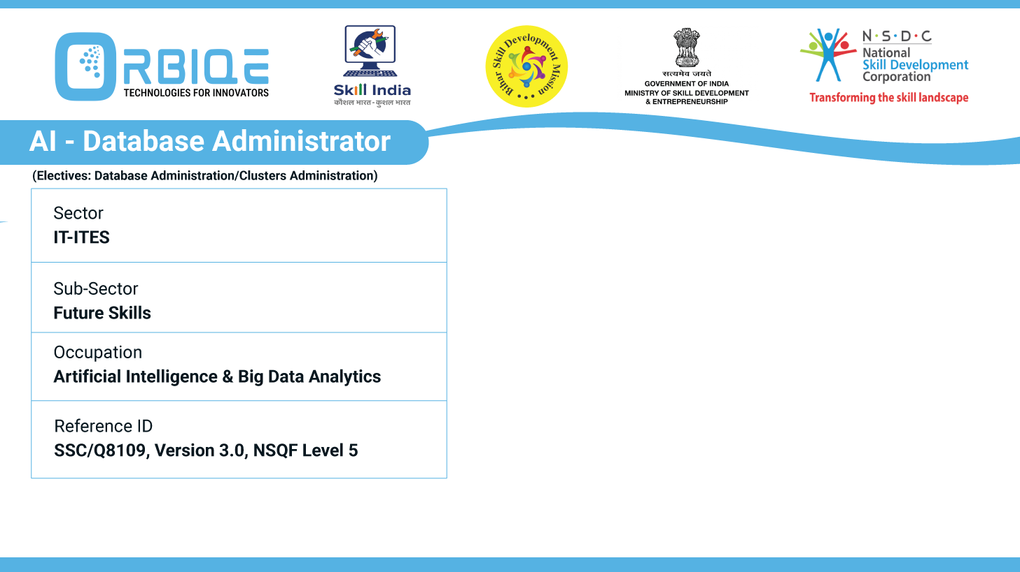
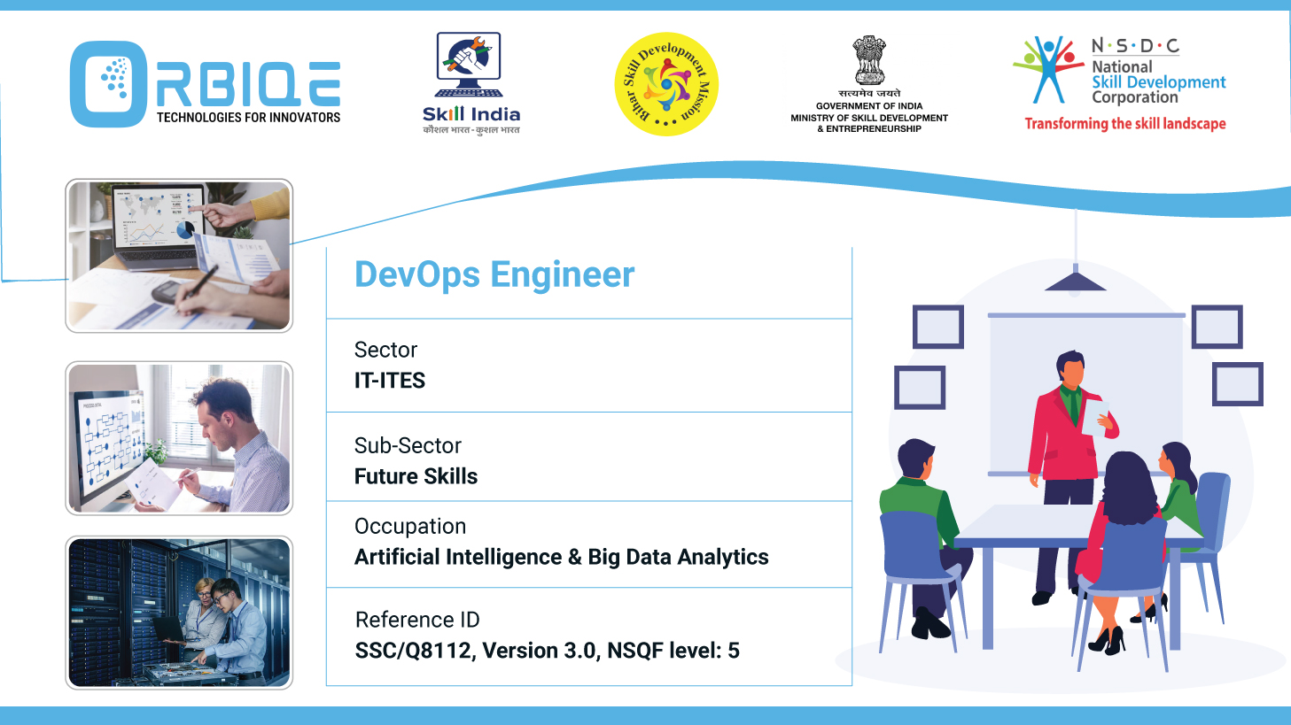
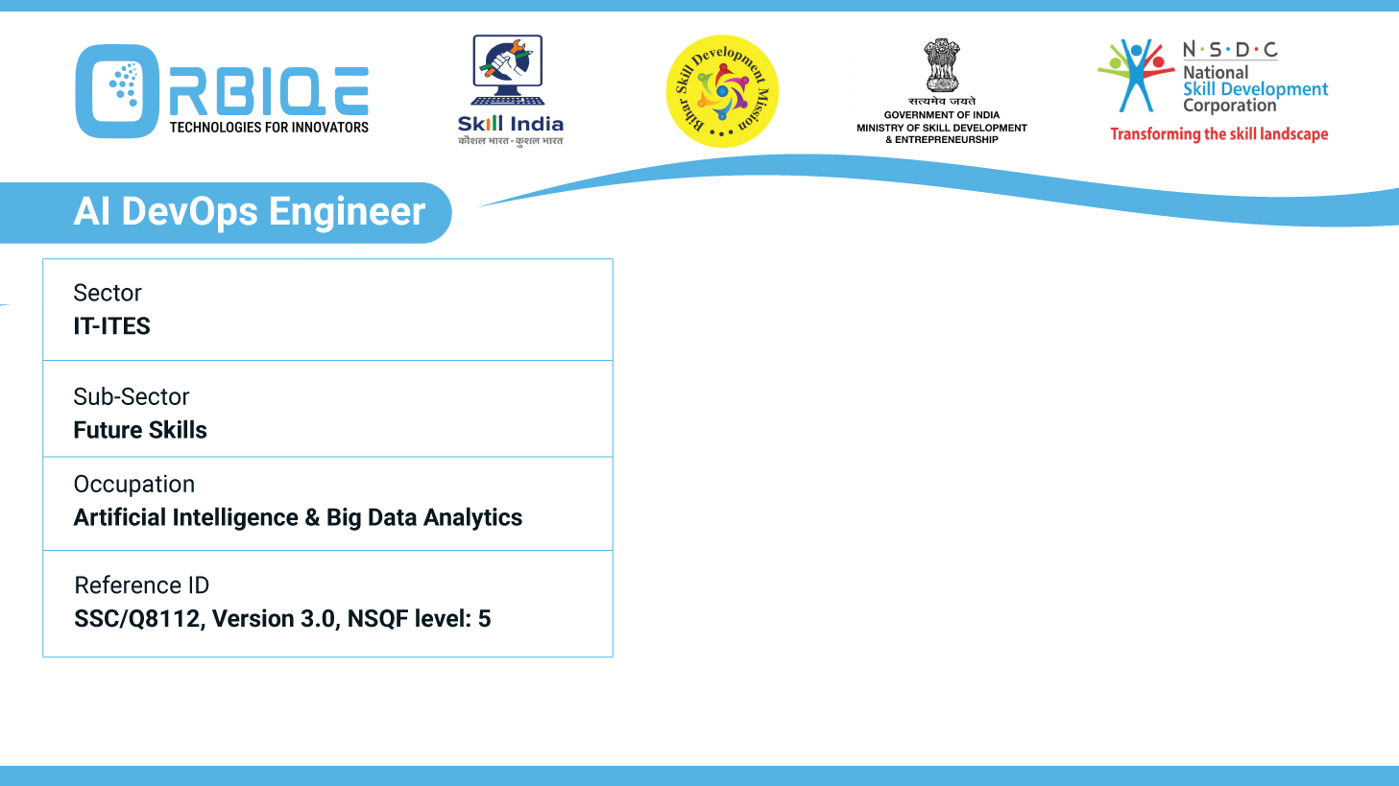
Name- Krishna Kant Dubey

Slide 2

Automation and Optimization: Tools for Efficient Data Management

Slide 3
Agenda
Tools for configuration management, continuous integration and development
Test automation, enabling efficient and optimized data management practices for AI Database Administrators.

Slide 4
Tools for configuration management
Ansible
Agentless, YAML-based playbooks, great for app deployment and config tasks
Puppet
Declarative language, cross-platform support,
strong enterprise capabilities
Chef
Ruby DSL, infrastructure as code, scalable automation

Slide 5
Key Areas of Database Testing to Automate
Test Type | Purpose
Schema Validation | Ensure primary/foreign keys, constraints, and relationships are intact.
Data Accuracy | Verify that data matches expected formats and values.
Stored Procedures | Test logic, performance, and output of procedures and triggers.
Backup & Recovery | Validate that backups are restorable and complete.
Concurrency Testing | Ensure consistency under simultaneous access.
Migration Validation | Confirm data integrity post-migration.
Performance Testing | Analyze query response under load.

Slide 6
Key Areas of Database Testing to Automate
Tools | Features
testRigor | AI-based automated database testing with schema and query validation
AI2SQL | Converts natural language to SQL queries for test generation
SupaSQL | AI Copilot for SQL query creation and optimization
TestGrid | Predictive test coverage and anomaly detection
DbSensei | AI-powered SQL diagnostics and performance tuning

Slide 7
Thank You

